Slide 1
Airbnb
Nasser Othman

Slide 2
AGENDA
Introduction​
Primary goals
​Visualizations
​

Slide 3
Introduction
Option 2: Airbnb Dataset
6 Visualizations and 1 Dashboard

Slide 4
Visualizations
With Tableau

Slide 5
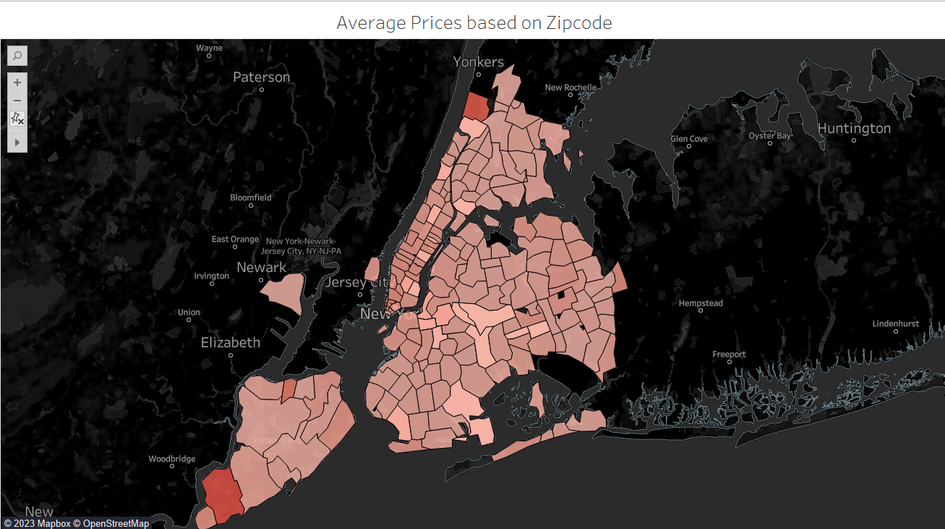
Average Prices/zipcode

Slide 6
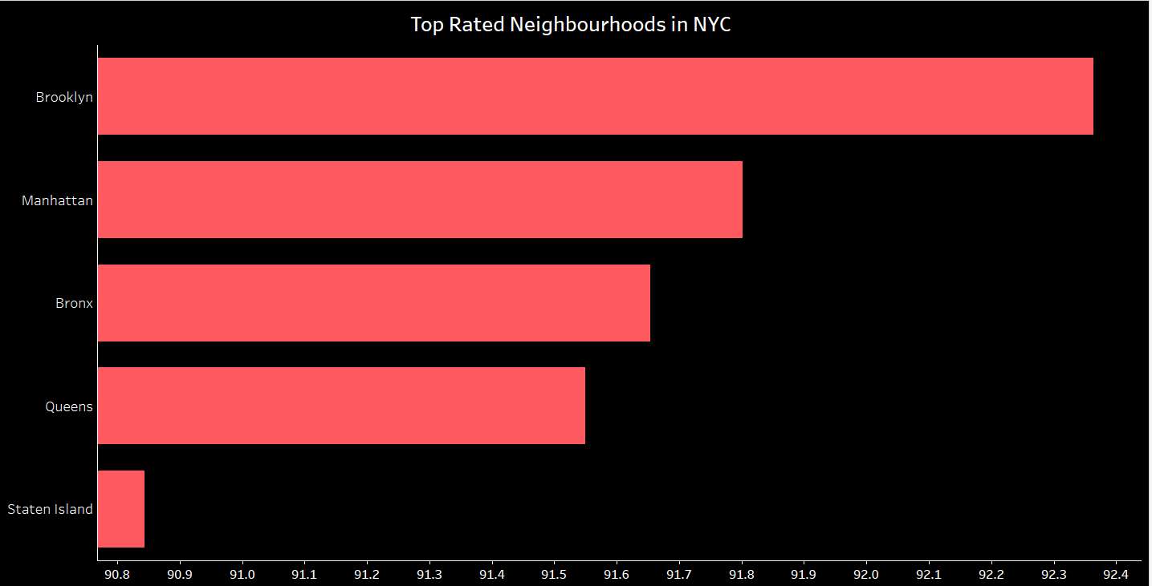
Top Rated Neighbourhoods

Slide 7
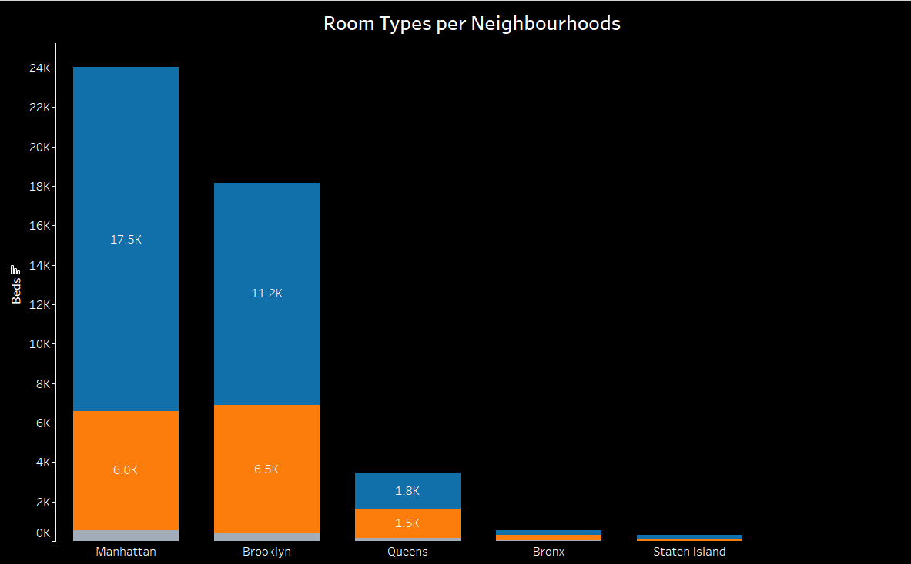
Top Rated Neighborhoods

Slide 8
THANK YOU
Nasser Othman

